Slide 1
AIML CA2 Unsupervised Clustering
Done By: Darius (2222259)

Slide 2
01.
EDA
Exploratory Data Analysis

Slide 3
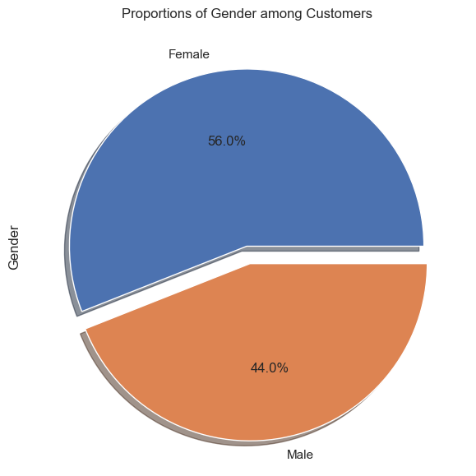
EDA
Surprisingly, the female shoppers and male shoppers recorded are quite equal suggesting no class imbalance.
So can I just remove Gender column since its equal between the 2,
Well, no by right gender will tell us certain spending habits so we can’t outright remove it. We will need to do further testing before we do anything

Slide 4
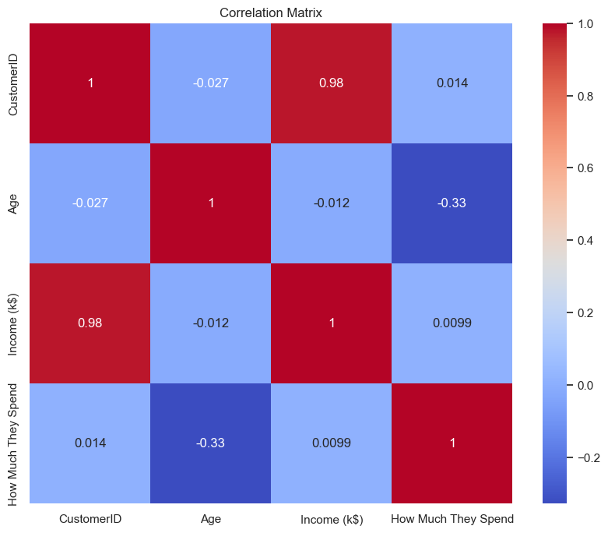
EDA
Correlation plot
For the correlation plot, most of the features look quite normal with no feature being overly correlated with one another, except for a strange correlation between customer_id and income which shouldn’t really mean much since customer id doesn’t provide any information. Most likely they sort the data by asc of income hence its so related.

Slide 5
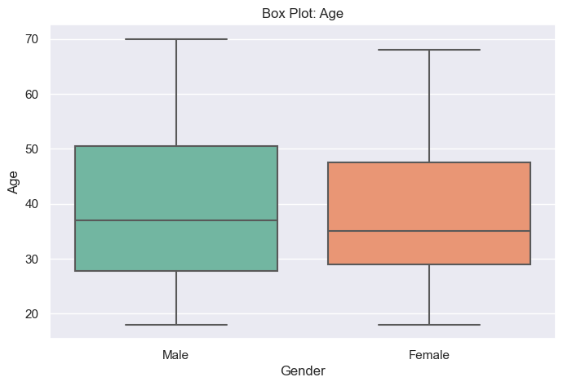
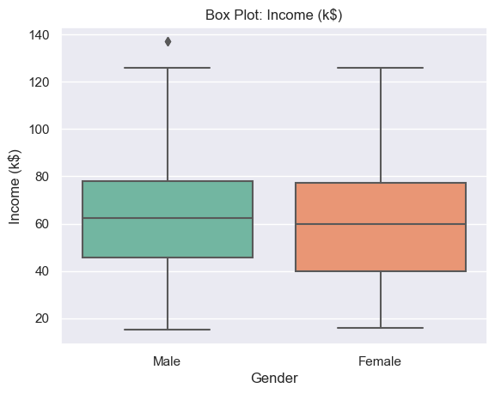
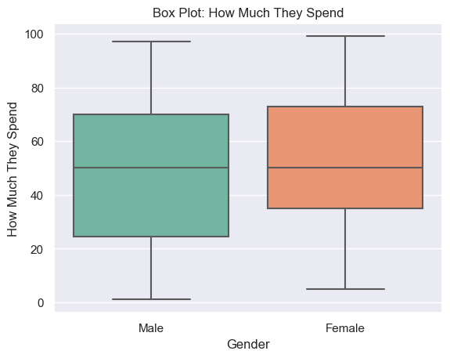
EDA
Box plot
I mentioned the possibility of dropping gender just now, so let's take a look at if there are any differences based on gender In this dataset, based on all 3 boxplots of the other features, the difference between the 2 is almost non-existent. However, this doesn’t provide all the justification we need to drop it, until further test is done we will leave gender alone

Slide 6
02.
Preprocessing
Process the data so that it can be used for clustering

Slide 7
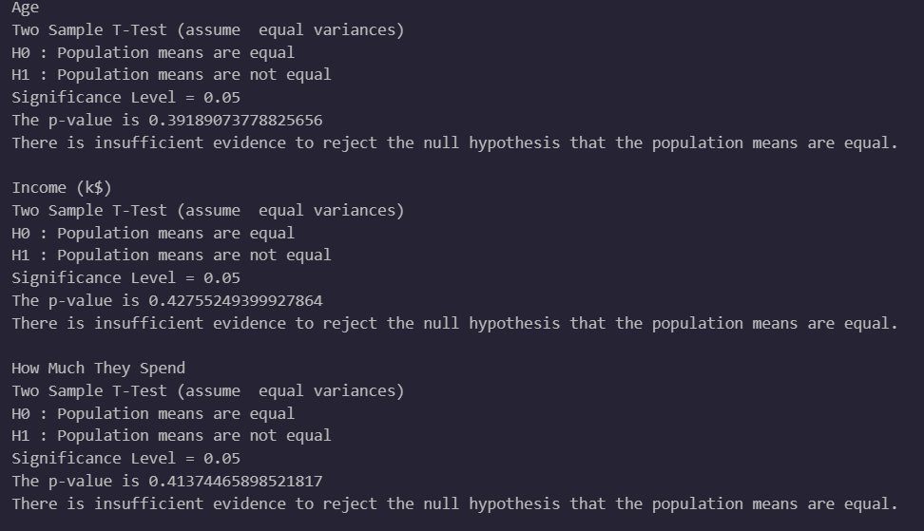
Preprocessing
Feature Engineering
To drop Gender once and for all, I need to prove that the means between the 2 gender are the same and there is no difference between the 2/ use in keeping it
To do that I used a two-sample t test and evaluated it on all features
The results shows that the means are equal allowing me to drop them since the gender doesn’t contribute to anything

Slide 8

Data Preparation
Tendency Test
Before I started clustering, I want to see if the dataset has natural clusters making it easier for clusters to be formed when using a clustering model,
I used Hopkins Statistics to calculate this
0 means a no clustering tendency, while 1 suggest strong clusters
Our score tells us that our data is moderately clustered however the clusters might not be very defined

Slide 9
03.
KMeans
Lets start clustering with KMeans

Slide 10
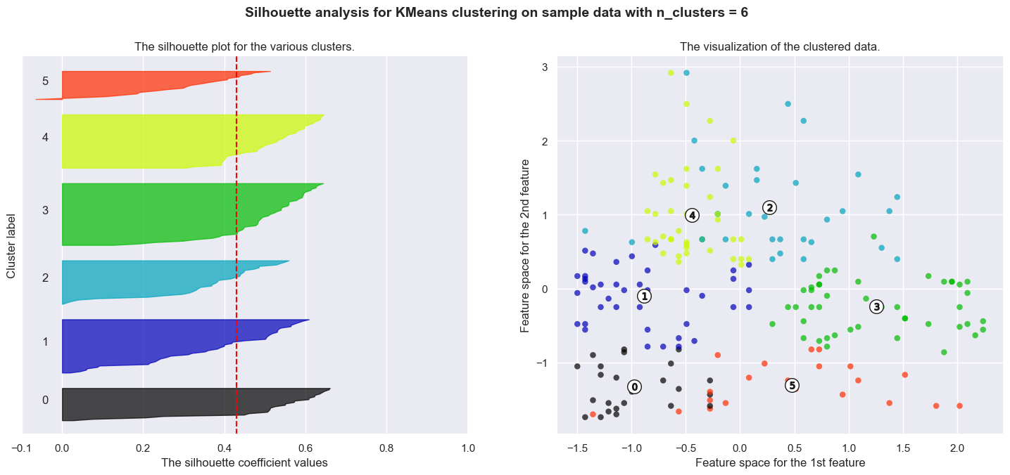
KMeans
Silhouette Analysis
After fitting the model with our chosen number of clusters ranging from 6 – 10 we have to look at how well they perform.
Out of the 5 we tested, I can say n_cluster = 6 gave not only the best silhouette score but the also the most distinguishable clusters
Hence for now KMeans with n_cluster = 6 is our best model

Slide 11
04.
DBSCAN
Lets try a new model: DBSCAN

Slide 12
05.
Hierarchical Clustering
Finally let's use Hierarchical Agglomerative Clustering

Slide 13
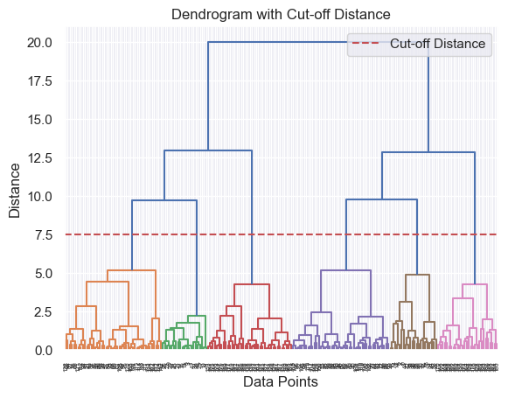
Hierarchal Clustering
Dendrogram analysis
Unlike the other models hierarchal clustering doesn’t really need parameters, so I let it run and see how it naturally split clusters.
After plotting and inspecting the dendrogram I decided to cut it at 7.5 distance as afterwards the clusters were getting smaller which might not really provide useful information

Slide 14
06.
Final Model
Lets pick the model we will go with

Slide 15
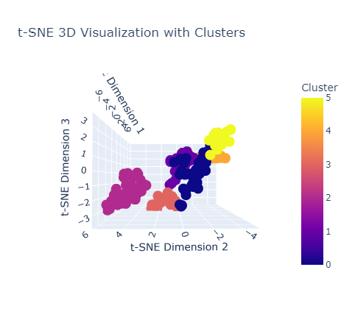
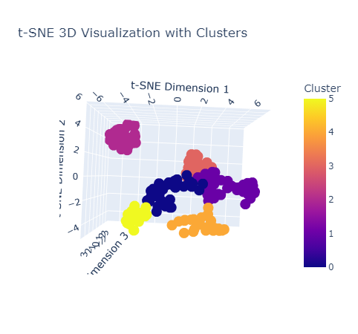
Final
Based on the visualized clusters, its clear which model performed the best and that is Hierarchical Agglomerative Clustering which showed the most distinct clusters, let’s now visualize it in 3d
Once again even in a 3d environment the clusters are extremely well formed clear and distinct,
Lastly we just need to infer information from the clusters

Slide 16
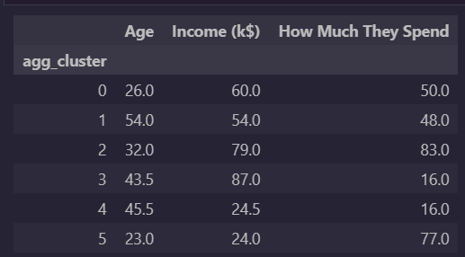
Hierarchal Clustering
Centroids Analysis
Once again, I inspected the centroids to see information about each clusters, however this time I used median, since the clusters are so well separated I feel it’s a no brainer to use median.
We can see each type of customer belong to which cluster
The next part I will suggest which cluster should the shopping mall try to retain

Slide 17
07.
Recommendations
Suggestion for the shopping mall

Slide 18
Recommendations
Lets first see all the clusters and what type of customers are they:
- cluster 1: younger generation with high income, as well as relatively high spending for their age
- cluster 2: Older generation with average income, as well as average spending
- cluster 3: middle-aged with higher income and strong spending ability
- cluster 4: middle-middle aged customer with very high income however spending very frugally
- cluster 5: middle-middle aged customer with low income as well as low spending
- cluster 6: young customers with low income however extremely high spending

Slide 19
Recommendations
The most important customers to keep are in group 1. There are two main groups that matter: group 1 and group 3. However, it's better to focus on keeping group 1. They're young but have good income and spend average for now. This means their spending will likely increase over the next few years, making them more valuable than group 3. So, to help the mall the most, it's smart to focus on keeping customers in group 1 as they will bring more profit over time.

Slide 20
Thanks!
#Slidesgo2XXX
Do you have any questions?
Please keep this slide for attribution

